Slide 1

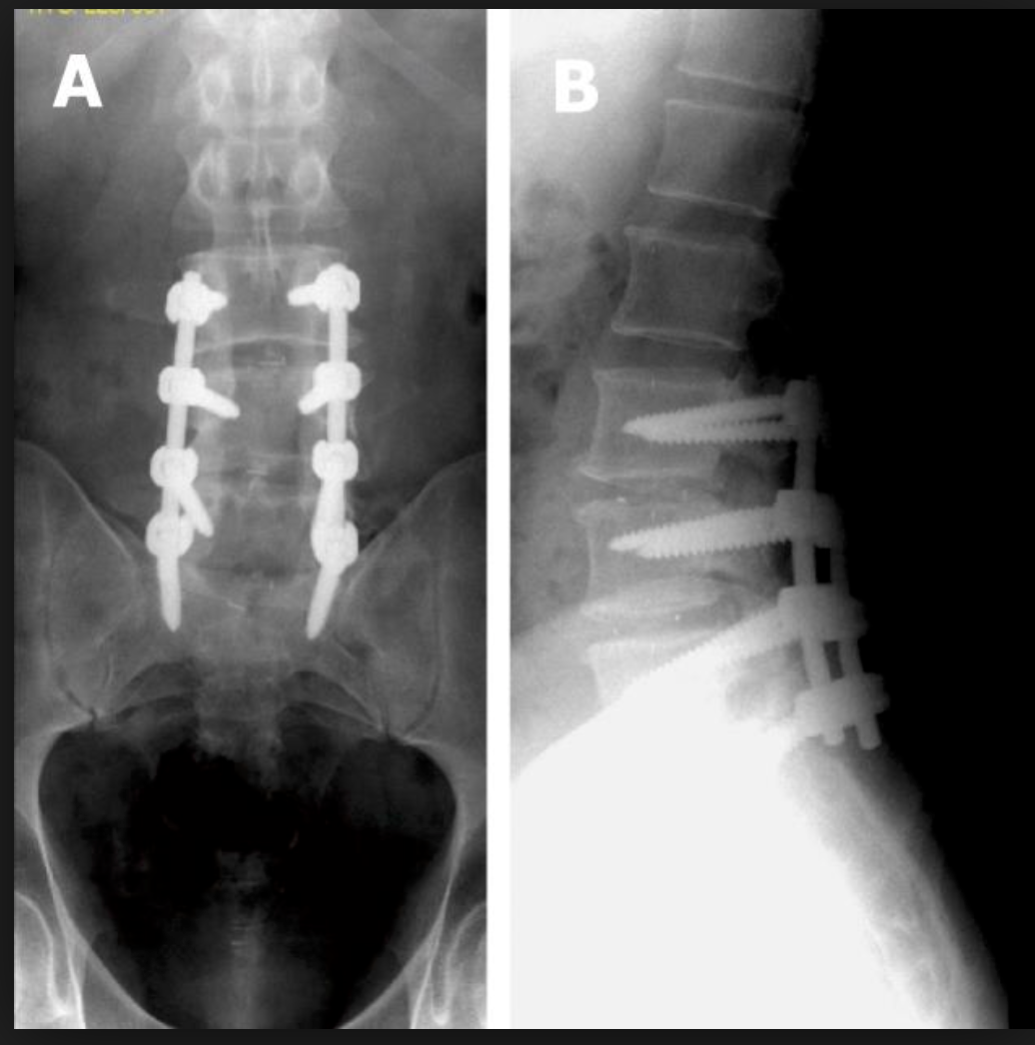
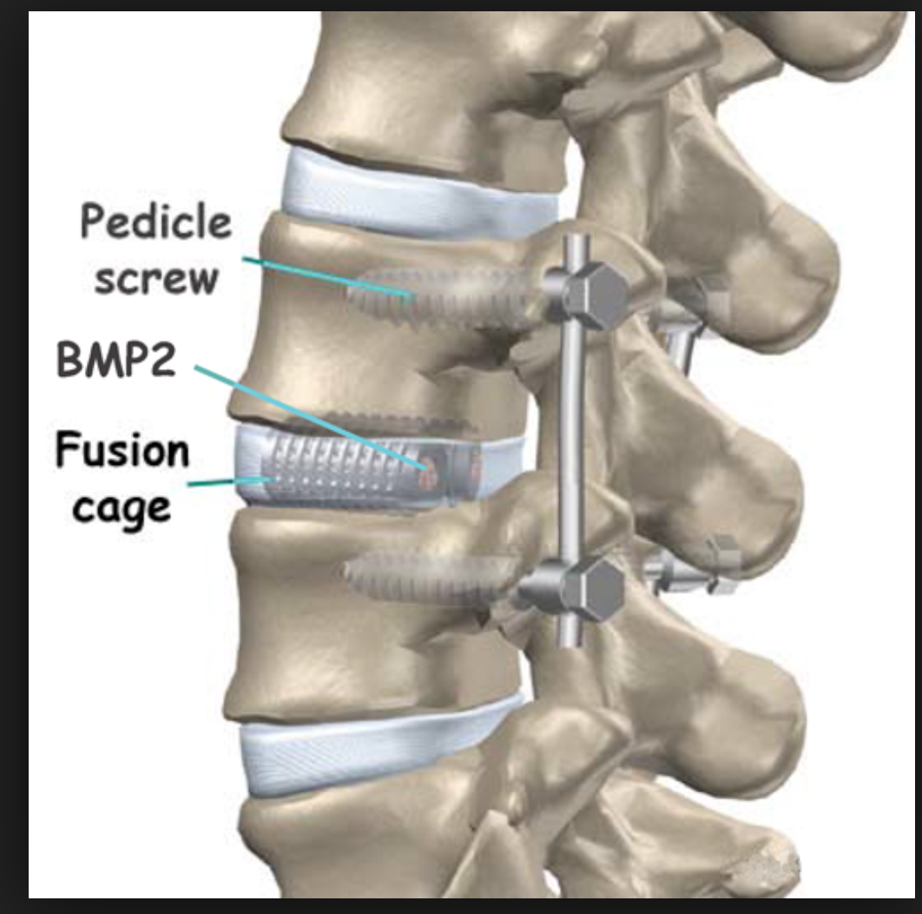
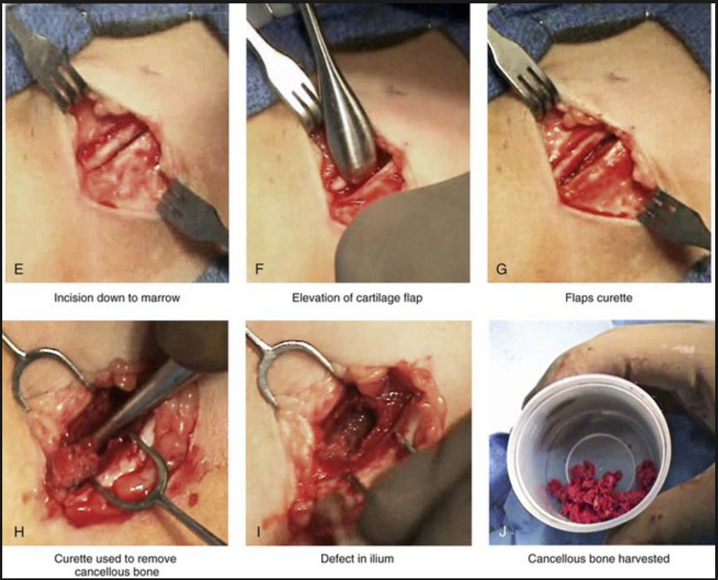
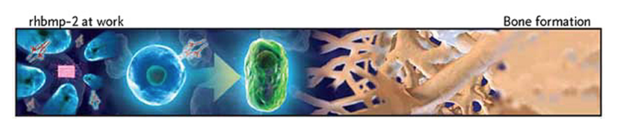
Use of rhBMP-2 vs. Autogenous iliac crest bone graft in lumbar fusion
Manpreet Kaur Bassi, BS, Rolando Roberto, MD
University of California School of Medicine, Sacramento, CA, USA
INTRODUCTION
MATERIALS AND METHOD
RESULTS
CONCLUSION
Spinal fusion is one of the most frequently performed operations used to treat degenerative spinal conditions.
Degenerative spondylolisthesis is a common degenerative pathology that results in mechanical instability, severe low back pain and produces neural compression, i.e. lumbar spinal stenosis.
Surgical intervention in the form of laminectomy and fusion results in relief of neural compression with subsequent improved ambulatory capacity and significant reduction in back pain
For decades laminectomy was accompanied by posterolateral fusion with the use of rigid spinal internal fixation and autogenous bone graft harvested from the iliac crest.
Despite the relative ease of bone graft harvest, published literature has documented high rates of complication including, early harvest site pain, hematoma and or seroma, formation and in severe cases chronic pain at the harvest site.
With the discovery of the TGF beta super family of genes and the commercial availability of recombinant Human Bone Morphogenic protein (rh-BMP2/ Infuse) the option to implant a human derived osteogenic protein arose, obviating the need for autogenous bone graft harvest.
Rh BMP-2 is capable of stimulating heterotopic bone formation at implanted sites including in the posterolateral inter-transverse interval traditionally used for posterolateral spine fusion.
Rh BMP-2, however, received FDA approval as a device (despite its pharmacologic or biological profile) when used in the anterior lumbar spine when included with the Lumbar threaded interbody cage.
High concentration preparations (Amplify) were not approved for clinical use by the FDA as patients receiving high dose preparations were noted to have significantly higher remote site rates of malignancy.
In clinical use seroma formation can be commonly noted when used in the lumbar and cervical spine, which may require return to the operating room for irrigation and decompression of neural element compression, which may occur in individuals undergoing laminectomy.
Finally, as rh BMP-2 is licensed to one Biotechnology corporation (Medtronic) costs have remained high with a single 12 mg dose (most common administered dose) remaining fixed at $5,000 US per application.
-Patients were identified from the UCDHS records who have undergone lumbar decompression and fusion at one or two levels for degenerative pathologies during the time frame spanning 2005-2015.
-A matched cohort of patients 30 undergoing fusion with rh-BMP-2 were compared to a similar group of patients who underwent fusion with autogenous iliac bone graft as the bone graft source.
-Charts were reviewed for
Age
Smoking/Alcohol history
Level of fusion
rhBMP-2 vs. autograft only
Operative time (estimated by open incision and anesthesia)
Estimated blood loss
All complications and comorbidities (eg. ASA status, anemia, postoperative infection, hematoma or seroma ), actual length of stay and mobility status on hospital discharge.
-Postoperative x-rays were graded for presence or absence of fusion using the Bridwell and Lenke grading scale.
-Inclusion criteria:
Age >18
Only posterior lumber spine one, two, three level included (excluded thoracic or thoracic plus lumbar spine)
At least one year follow up with lumbar spine x-rays
-Patients in the two comparison groups were matched for co-morbidities, age, sex, race, and gender.
-For lumbar spine fusion, rhBMP-3 and iliac crest bone graft were similar in overall success, fusion, and other effectiveness measures.
-There was one case of hematoma associated in rh BMP-2 group.
-There were no cases of malignancy in either groups.
-The fusion rate was similar among both groups with slight higher and faster rate of fusion among rh BMP-2 groups.
-On subjective interpretation, although both groups had similar number patients with back pain after 6 months; however, the quality and quantity of pain was different. The rh BMP-2 patient had minimal pain which was controlled with pain medications such as Tylenol or Norco. However, the patients with auto graft not only had back pain but also site pain.
Limitations and ways to improve study in future:
-Surveying the patient directly rather depending on the chart for pain control and overall satisfaction. (Helps to exclude physician subjective interpretation)
-Larger Sample Size
-Not only comparing the cost of procedure but also including the entire hospital stay extending up to 6 months after post op (procedure, anesthesia, pain medications)
-Comparing and grading fusion group was very subjective and limited to expertise (medical student). Thus, having two reviewers and adding one expert in reading radiologic images will greatly improve the validity of this study.
REFERENCES
1. Hustedt, Joshua W., and Daniel J. Blizzard. “The Controversy Surrounding Bone Morphogenetic Proteins in the Spine: A Review of Current Research.” The Yale Journal of Biology and Medicine 87.4 (2014): 549–561. Print.
2. Fu R, Selph S, McDonagh M, Peterson K, Tiwari A, Chou R, et al. “Effectiveness and Harms of Recombinant Human Bone Morphogenetic Protein-2 in Spine Fusion: A Systematic Review and Meta-analysis”. Ann Intern Med. 2013;158:890-902.
3. Paul M. Arnold, MD, Karen K. Anderson, BS, Kevin T. Foley, MD, FACS. “Heterotopic Ossification following Single-Level Anterior Cervical Discectomy and Fusion: Results from a Prospective, Multicenter, Historically-Controlled Trial Comparing Allograft to an Optimized Dose of rhBMP-2.” The Spine Journal 15.10 (2015), Pages S180.
4. Younger, Edward M, and Michael W. Chapman. "Morbidity at Bone Graft Donor Sites." Journal of Orthopaedic Trauma. 3.3 (1989): 192-195. Print.
5. Palmer, W, A Crawford-Sykes, and RE Rose. "Donor Site Morbidity Following Iliac Crest Bone Graft." The West Indian Medical Journal. 57.5 (2008): 490-2. Print.
6. Tao Hu, MDª, Sunny Akogwu Abbah, MBBS, PhDª, Soo Yein Toh, BScª, Ming Wang, MDª, Raymond Wing Moon Lam, PhDª, Mathanapriya Naidu, MScª, Gajadhar Bhakta, PhD^{b}, Simon M. Cool, PhD^{a, b}, Kishore Bhakoo, PhD^{a, c}, Jun Li, PhD^{d}, James Cho-Hong Goh, PhD^{a, d}, Hee-Kit Wong, FRCS^{a,} “Bone marrow-derived mesenchymal stem cells assembled with low-dose BMP-2 in a three-dimensional hybrid construct enhances posterolateral spinal fusion in syngeneic rats.” The Spine Journal 15.12 (2015): 2552-2563
HYPOTHESIS
Our hypothesis:
The use of rhBMP-2 is associated with an equivalent fusion rate in one and 2 level lumbar fusion when compared to autogenous iliac crest bone graft.
The reduction in complications associated with rh BMP-2 use when combined with a decrease in length of hospital stay justifies the cost of a single dose of rh BMP-2.
Our null hypothesis:
1.) rh BMP-2 is not associated with lower complications or cost when compared to autogenous iliac crest bone graft when used for one and two level lumbar fusion.
ACKNOWLEDGEMENT or CONTACT
Thank you to the MSRF funding committee for providing the financial support to conduct and complete this research project.
Thank you to Dr. Rolando Roberto for your guidance and mentorship during the completion of this project.
Manpreet Kaur Bassi, MS3
mbassi@ucdavis.edu
-Fusion Rate was similar among both groups.

